Slide 1

SpamShieldSMS :- A Spam SMS Detection Model Using ML
Tejas Kalokhe (22106049)
Ranjit Kadam (22106034)
Sahil Govardhane (22106097)
Sanket Kudale (22106059)
Project Guide
Mrs. Suruchi Ruiwale

Slide 2
Outline
Introduction
Literature Survey of the Existing Systems
Limitations of the Existing Systems
Problem Statement
Proposed System Design
Framework/Algorithm
Technologies Stack for Proposed System
Details of Database / Input to the System
Implementation
Conclusion
References

Slide 3
Introduction
Context and Importance of SMS Communication:
SMS is a fundamental tool for communication across various sectors including personal, business, corporate, and government domains.
With the exponential growth in email usage, it has become a critical channel for various forms of interaction and information exchange.
Rise of SPAM SMS:
Alongside the growth in legitimate email usage, there has been a significant increase in unsolicited and often malicious communications known as SPAM or junk SMS.
SPAM SMS involve the mass dissemination of nearly identical messages to numerous recipients without their consent.
Security Risks and Economic Impact:
Beyond being a nuisance, SPAM emails pose serious security risks such as phishing attempts, malware distribution, and other cyber threats.
The economic impact of SPAM is substantial; in 2007, it was estimated that SPAM-related issues cost businesses worldwide approximately $100 billion.

Slide 4
Introduction
Problem Observations:
SPAM tactics are becoming more sophisticated, with increasing numbers bypassing even advanced filters.
The associated security risks and economic losses highlight the need for a more effective, adaptive SPAM filtering system.
Challenges with Current Solutions:
Current SPAM filters struggle with accuracy, leading to false positives and negatives.
The evolving nature of SPAM tactics necessitates dynamic, adaptive filtering approaches.
Developing a Robust SPAM Filter:
The primary objective is to create an automated SPAM filtering system, specifically for SMS, that can accurately classify messages as SPAM or HAM.
The system will leverage advanced text mining and data mining classification algorithms to discern patterns within email content.

Slide 5
Introduction
Improving Communication Efficiency and Security:
The proposed solution aims to enhance the efficiency of email communication by reducing the clutter of SPAM SMS.
It also seeks to fortify digital infrastructures against potential security breaches caused by malicious SPAM SMS.
Adaptation to Evolving SPAM Tactics:
The solution will be designed to adapt to evolving SPAM techniques, ensuring long-term efficacy and resilience against emerging threats.

Slide 6
Literature Survey of the existing system
Temporal Naive Bayes Classifier (2024):
Introduces a framework that uses temporal dynamics for spam detection.
Adapts to evolving spam patterns by analyzing time-based features.
Machine Learning Algorithms (2023):
Comparative study of ML models (e.g., SVM, Naive Bayes) for spam detection.
SVM achieves the highest accuracy at 98.09%.
Deep Learning Approaches (2022):
Utilizes LSTM and BERT for spam detection, with BERT achieving 99.14% accuracy.
Comprehensive ML Review (2021):
Extensive analysis of various ML techniques and their effectiveness in spam detection.
Empirical Comparative Study (2020):
Evaluates ML classifiers and ensemble methods, highlighting the benefits of ensemble models.

Slide 7
Limitations of Existing Systems
Feature Engineering:
Traditional techniques (e.g., bag-of-words, n-grams) struggle with complex semantics and contextual information.
Machine Learning Algorithms:
Naive Bayes, SVMs, and Random Forests perform variably based on dataset and spam characteristics.
Deep Learning Approaches:
RNNs and CNNs capture long-range dependencies but are computationally expensive and data-intensive.
Hybrid Models:
Combining multiple techniques can improve performance but poses design challenges.
Evolving Spam Techniques:
Spammers continuously adapt, challenging model effectiveness

Slide 8
Problem statement
Spam-filtering for text messages poses distinct challenges compared to email spam detection. Unlike emails, which benefit from extensive datasets, SMS spam databases are limited, hindering the development of robust detection models. The brevity of SMS messages restricts the number of features available for classification, and the absence of informative headers further complicates detection. Additionally, the informal and abbreviated language used in SMS messages makes it difficult for traditional email filtering algorithms to perform effectively. These challenges necessitate the development of specialized approaches, which are the focus of our SpamShieldSMS project.

Slide 9
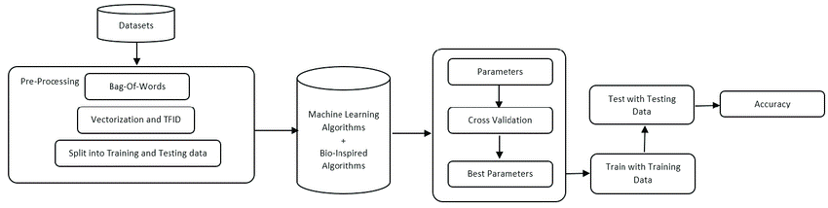
Proposed System Design
Fig.1 Workflow to build and test the model

Slide 10
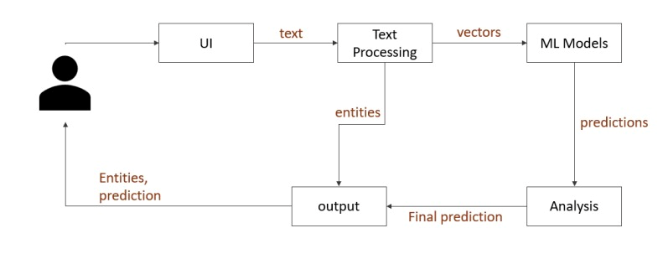
Proposed System Design
Fig.2 Working of the web app.

Slide 11
Algorithm
SVC (Support Vector Classifier):
Separates classes with a hyperplane, maximizing margin for spam detection.
KNN (K-Nearest Neighbors):
Classifies based on the similarity (distance) to neighboring examples.
NB (Naive Bayes):
Probabilistic classifier assuming feature independence, effective for spam detection.
DT (Decision Tree):
Creates rule-based classification using feature-based decisions at each node.
LR (Logistic Regression):
Predicts the probability of spam using a logistic function for binary classification.

Slide 12
RF (Random Forest):
Combines multiple decision trees to improve classification accuracy.
AdaBoost:
Iteratively improves weak learners for enhanced classification.
BGC (Bayesian Generalized Linear Models):
Models spam probability with prior knowledge and complex feature relationships.
ETC (Extremely Randomized Trees):
Uses highly randomized trees for efficient large-scale classification.
GBDT (Gradient Boosting Decision Trees):
Boosts performance by sequentially improving decision trees for better accuracy.
XGB (eXtreme Gradient Boosting):
An efficient and scalable gradient boosting method for large datasets.

Slide 13
Technologies Stack for Proposed System
Streamlit
NLTK(Natural Language Toolkit)
Pandas
Matplotlib & Seaborn
Scikit-Learn
WordCloud

Slide 14
Details of Dataset
Traning data is aquired from the following Kaggle dataset
Link :
SMS Spam Collection Dataset (kaggle.com)

Slide 15
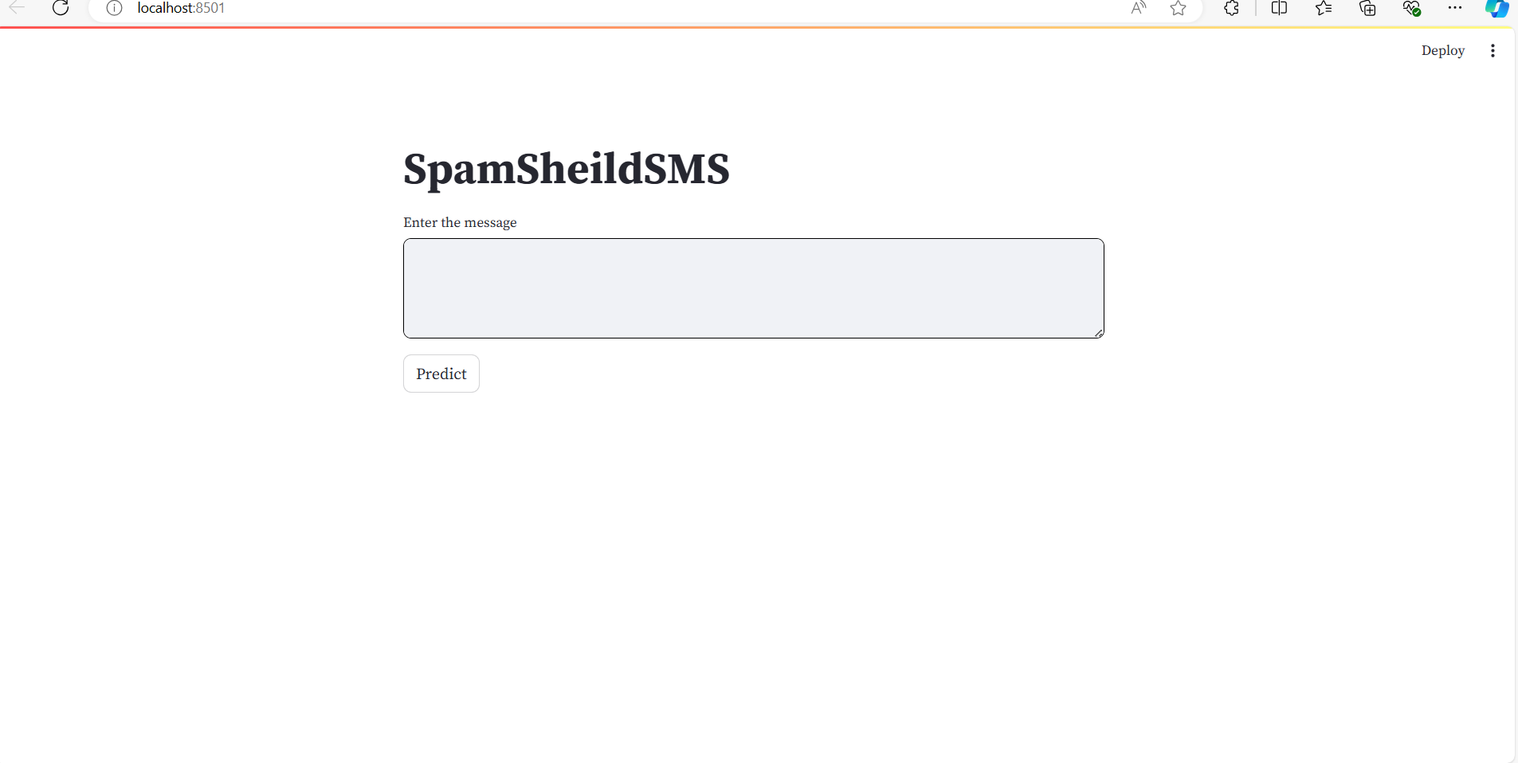
Implementation
Fig.User Interference

Slide 16
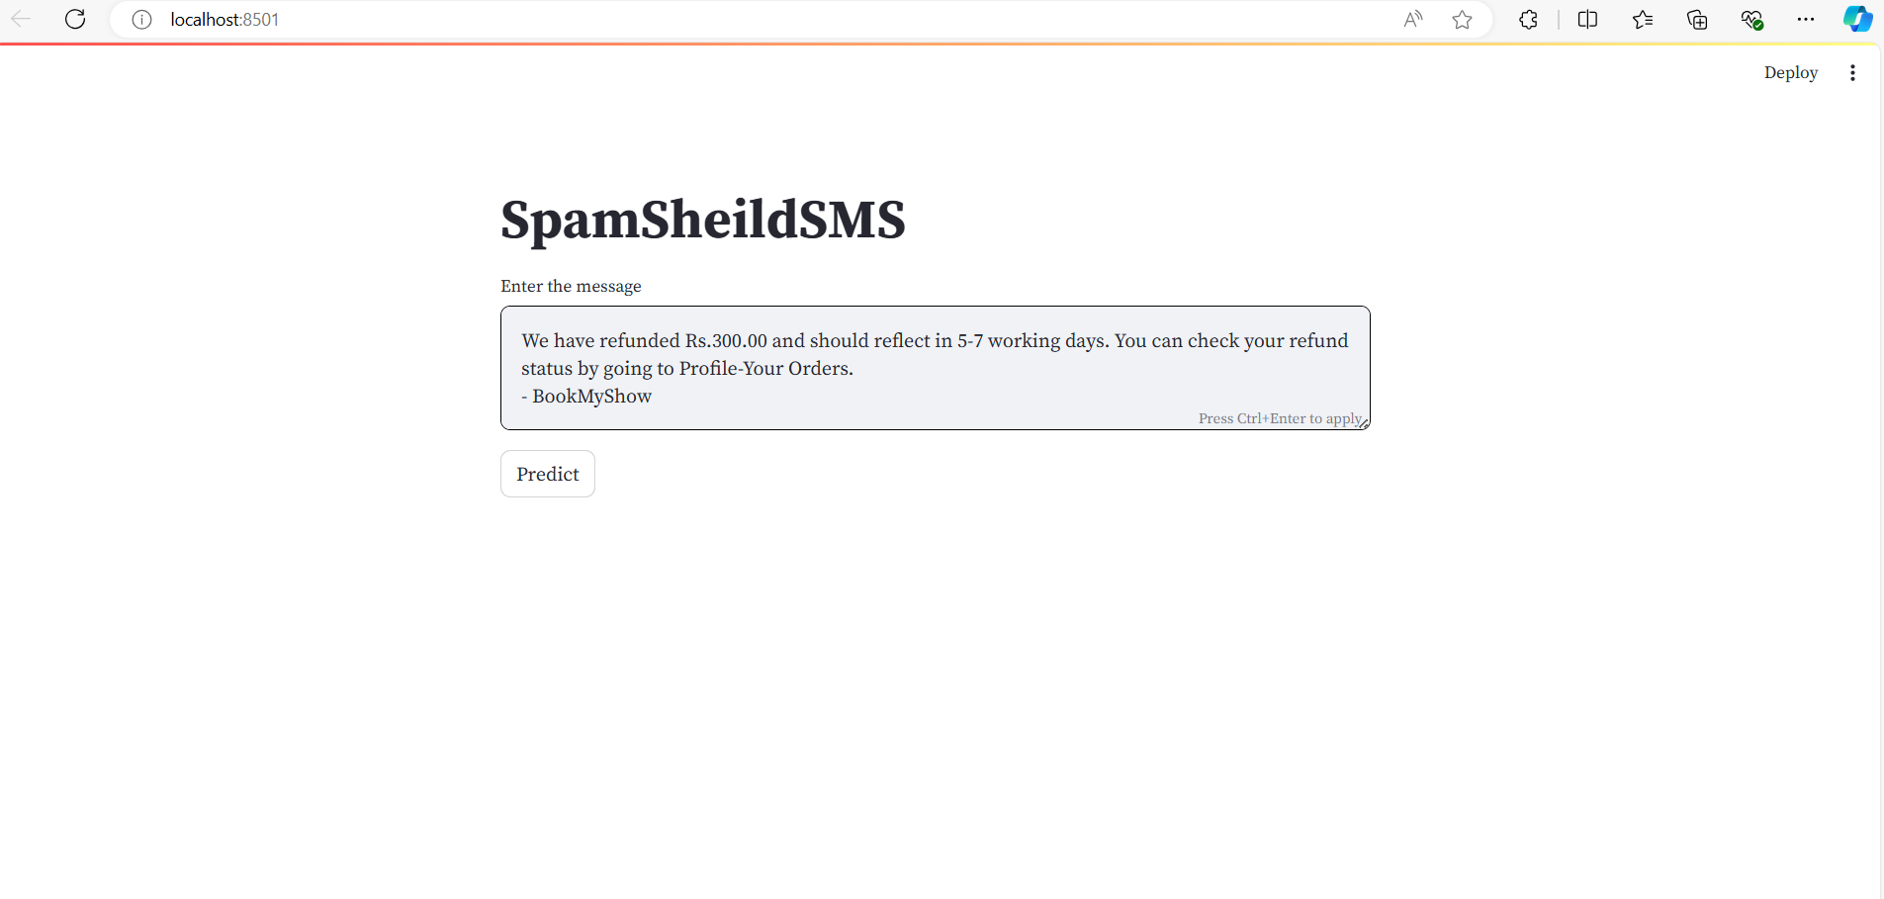
Implementation
Fig.Entering Message

Slide 17
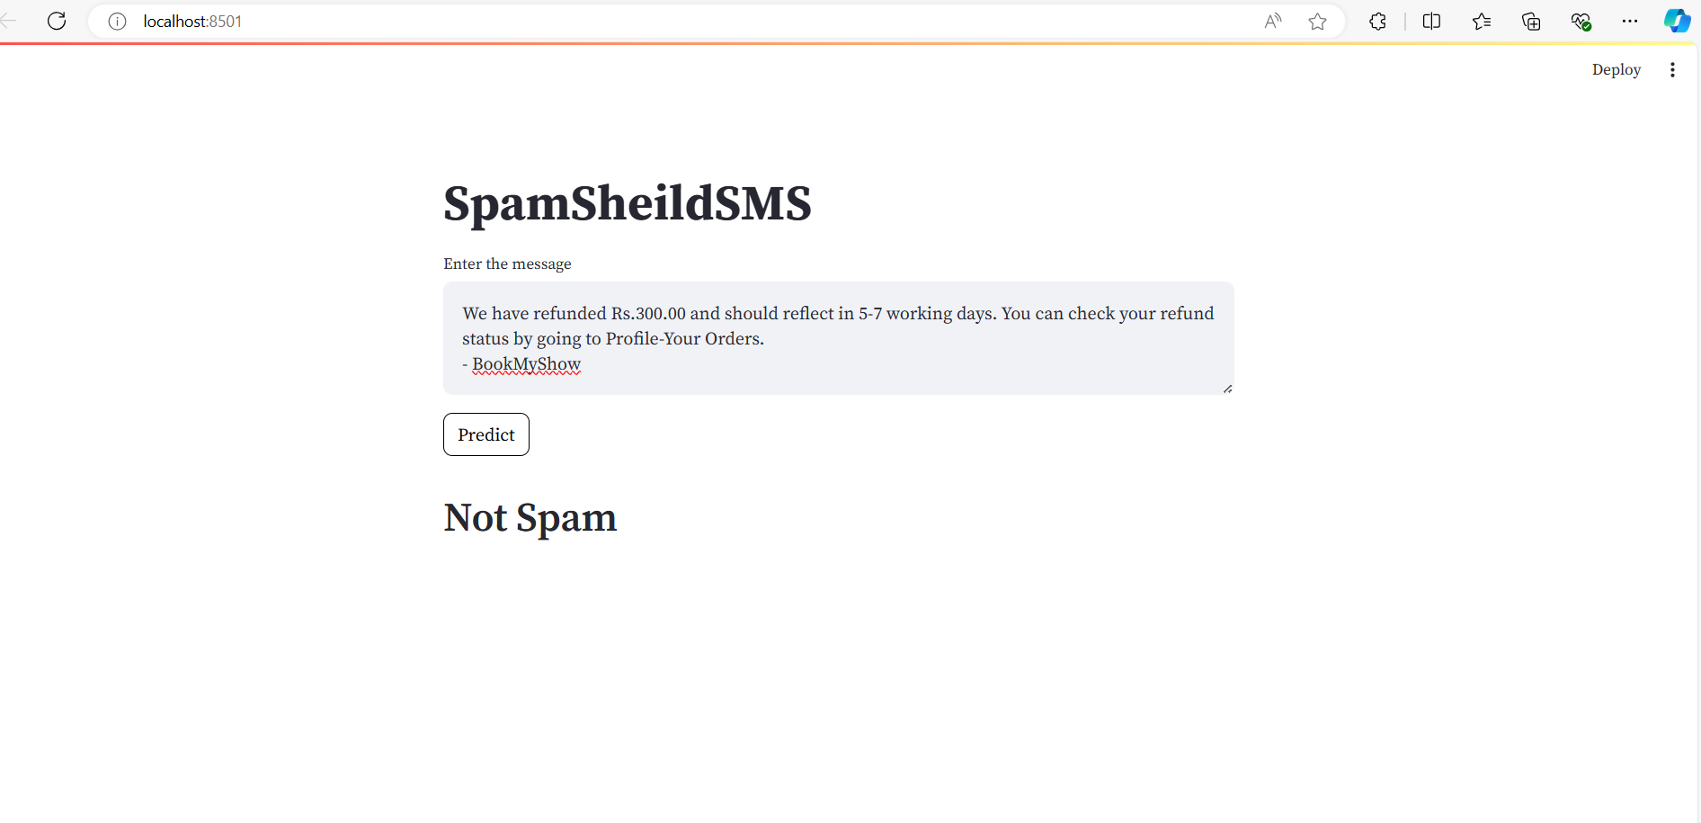
Implementation
Fig.Prediction

Slide 18
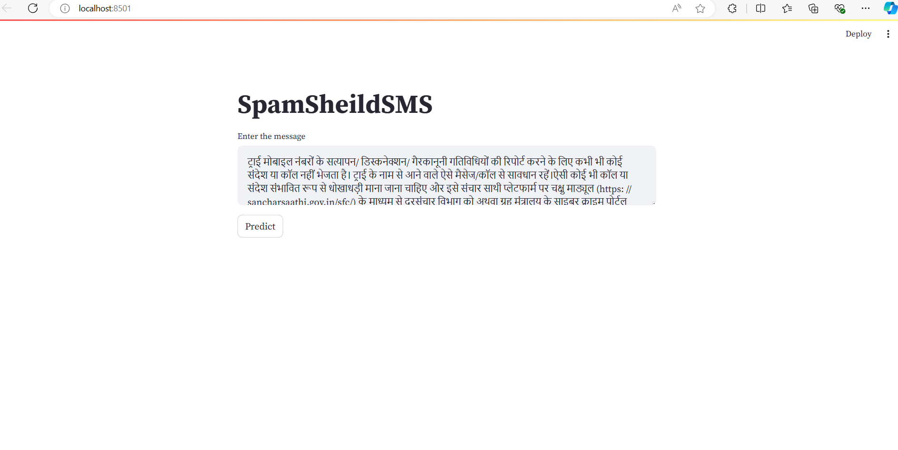
Implementation
Fig.Entering Another Message

Slide 19
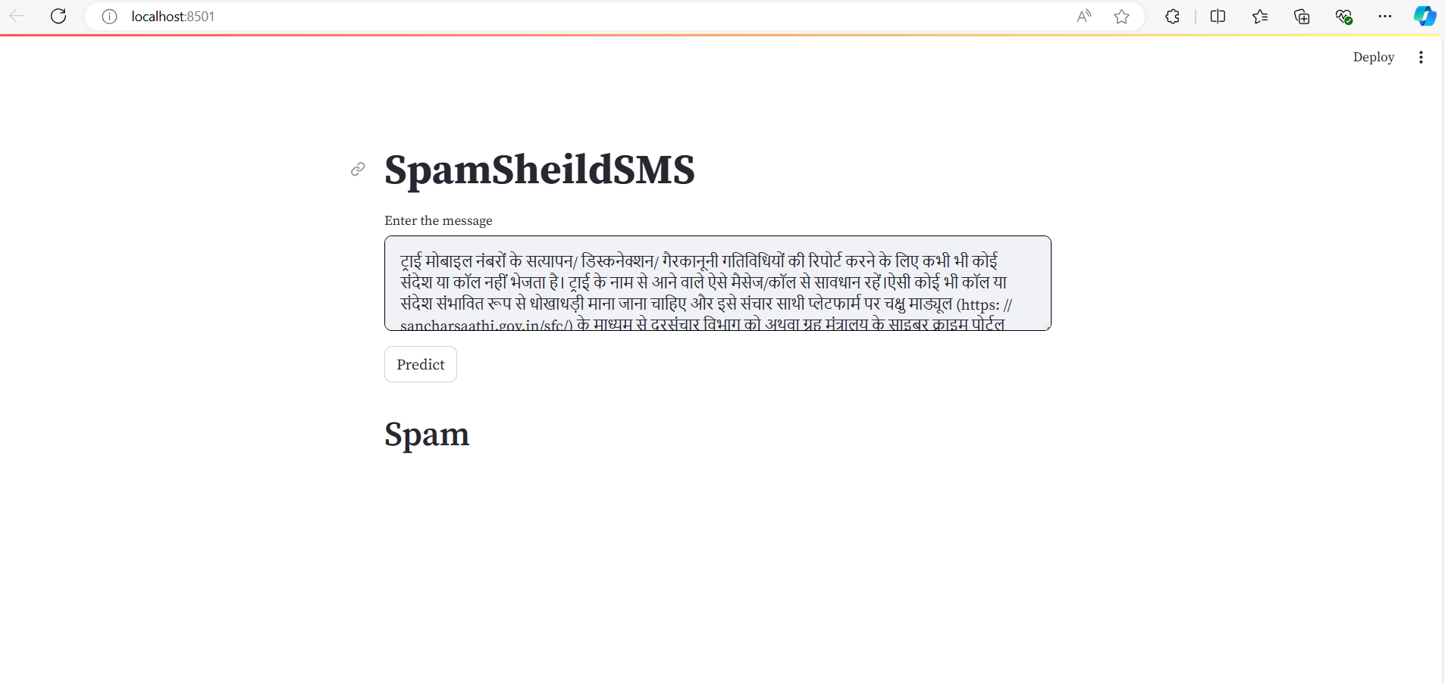
Implementation
Fig.Prediction

Slide 20
Conclusion
In conclusion, this spam SMS protection project has successfully addressed a pressing issue and provides a valuable tool for safeguarding individuals and organizations from the negative consequences of unwanted messages.

Slide 21
References
[1] J. Mythili, B. Deebeshkumar, T. Eshwaramoorthy, and J. N. Ajay, "Enhancing Email Spam Detection with Temporal Naive Bayes Classifier," IEEE Xplore, vol. 11, June 2024. Enhancing Email Spam Detection with Temporal Naive Bayes Classifier | IEEE Conference Publication | IEEE Xplore
[2] P. Thakur, K. Joshi, P. Thakral, and S. Jain, "Detection of Email Spam using Machine Learning Algorithms: A Comparative Study," IEEE Xplore, vol. 12, Jan. 2023 Detection of Email Spam using Machine Learning Algorithms: A Comparative Study | IEEE Conference Publication | IEEE Xplore
[3] K. Debnath and N. Kar, "Email Spam Detection using Deep Learning Approach," IEEE Xplore, vol. 15, Aug. 2022. Email Spam Detection using Deep Learning Approach | IEEE Conference Publication | IEEE Xplore
[4] M. Raza, N. D. Jayasinghe, and M. Magboul, "A Comprehensive Review on Email Spam Classification using Machine Learning Algorithms," IEEE Xplore, vol. 02, Feb. 2021. A Comprehensive Review on Email Spam Classification using Machine Learning Algorithms | IEEE Conference Publication | IEEE Xplore
[5] S. Suryawanshi, A. Goswami, and P. Patil, "Email Spam Detection: An Empirical Comparative Study of Different ML and Ensemble Classifiers," IEEE Xplore, vol. 30, Jan. 2020. Email Spam Detection : An Empirical Comparative Study of Different ML and Ensemble Classifiers | IEEE Conference Publication | IEEE Xplore

Slide 22
Thank You...!!

